Slide 1
Neural Networks

Slide 2
Neural Network
A specific set of machine learning methods that mimics how the human brain works
Consists of “neurons” that stack in layers
Each neuron in a layer takes output from neurons in its previous layer as inputs, and send it output to neurons in the next layer

Slide 3
Neural Network Illustration
Output neuron – represents the output of the neural network
Output layer
Hidden layers
Hidden neuron – internal computations occur here
Computational flow
Input layer
Input neuron – input data is fed into this layer
one data instance yields one set of input and one set of output

Slide 4
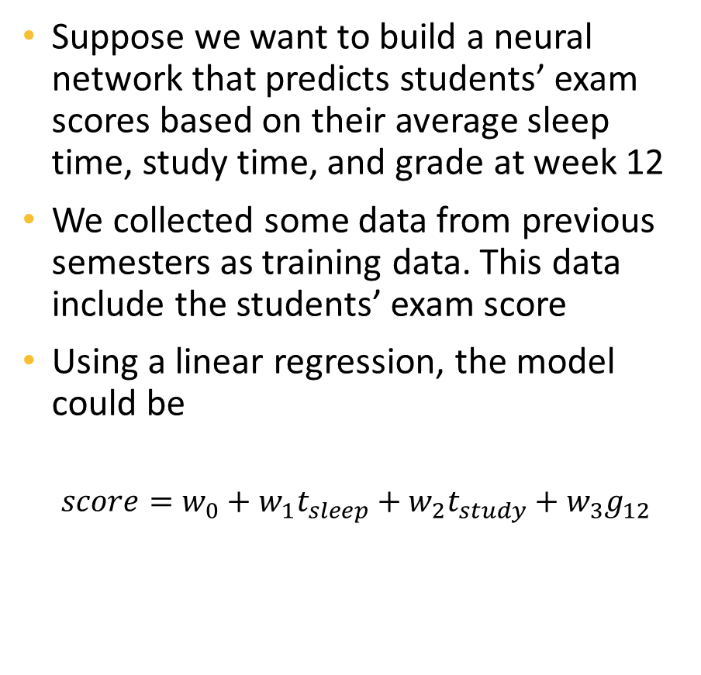
A Simple Example
Student ID | Sleep (hours) | Study (hours) | W12 Grade | Exam Score
000132 | 5 | 8 | 98 | 95
000631 | 6 | 7 | 95 | 93
120265 | 3 | 4 | 82 | 75
106889 | 6 | 2 | 91 | 92
236815 | 8 | 5 | 90 | 93
Suppose we want to build a neural network that predicts students’ exam scores based on their average sleep time, study time, and grade at week 12
We collected some data from previous semesters as training data. This data include the students’ exam score
Using a linear regression, the model could be
$$score=w_{0}+w_{1}t_{sleep}+w_{2}t_{study}+w_{3}g_{12}$$

Slide 5




The Neural Network
Student ID | Sleep (hours) | Study (hours) | W12 Grade | Exam Score
000132 | 5 | 8 | 98 | 95
000631 | 6 | 7 | 95 | 93
120265 | 3 | 4 | 82 | 75
106889 | 6 | 2 | 91 | 92
236815 | 8 | 5 | 90 | 93
The neural network could be as in the figure
Each node in a layer (except the input layer) is calculated using all nodes from its direct previous layer
$$score$$
$$t_{sleep}$$
$$t_{study}$$
$$g_{w12}$$

Slide 6



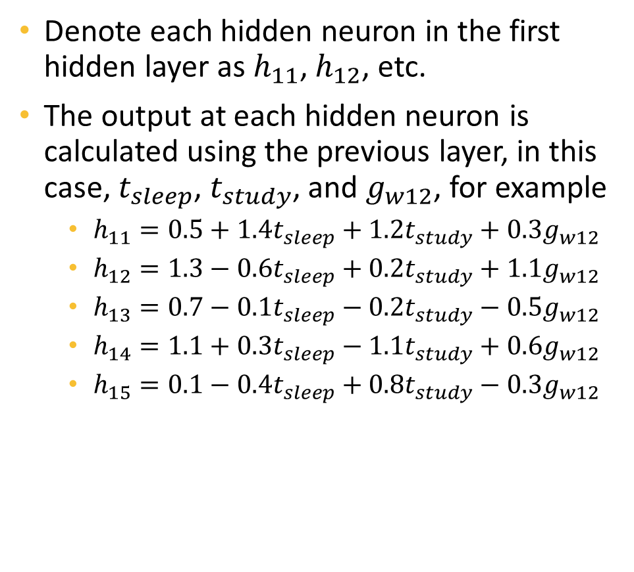





The First Hidden Layer
Denote each hidden neuron in the first hidden layer as $h_{11}$, $h_{12}$, etc.
The output at each hidden neuron is calculated using the previous layer, in this case, $t_{sleep}$, $t_{study}$, and $g_{w12}$, for example
$h_{11}=0.5+1.4t_{sleep}+1.2t_{study}+0.3g_{w12}$
$h_{12}=1.3−0.6t_{sleep}+0.2t_{study}+1.1g_{w12}$
$h_{13}=0.7−0.1t_{sleep}−0.2t_{study}−0.5g_{w12}$
$h_{14}=1.1+0.3t_{sleep}−1.1t_{study}+0.6g_{w12}$
$h_{15}=0.1−0.4t_{sleep}+0.8t_{study}−0.3g_{w12}$
$$h_{11}$$
$$h_{12}$$
$$h_{13}$$
$$h_{14}$$
$$h_{15}$$
Computational flow
$$t_{sleep}$$
$$t_{study}$$
$$g_{w12}$$

Slide 7











The Second Hidden Layer
Denote each hidden neuron in the second hidden layer as $h_{21}$, $h_{22}$, etc.
Similarly, the output at each hidden neuron is calculated using the previous layer, in this case, $h_{11},h_{12},h_{13},h_{14},$ and $h_{15}$, for example
$h_{21}=0.1+0.2h_{11}−0.3h_{12}−0.2h_{13}+0.7h_{14}+0.9h_{15}$
$h_{22}=0.2−0.7h_{11}−0.9h_{12}+0.3h_{13}−0.4h_{14}+0.9h_{15}$
$h_{23}=0.7−0.4h_{11}+0.1h_{12}+0.2h_{13}−0.5h_{14}−0.1h_{15}$
$h_{24}=0.1+0.3h_{11}+0.3h_{12}−0.1h_{13}−0.1h_{14}−0.3h_{15}$
$h_{25}=0.2−0.7h_{11}+0.2h_{12}−0.6h_{13}+0.2h_{14}−0.2h_{15}$
$$h_{21}$$
$$h_{22}$$
$$h_{23}$$
$$h_{24}$$
$$h_{25}$$
Computational flow
$$h_{11}$$
$$h_{12}$$
$$h_{13}$$
$$h_{14}$$
$$h_{15}$$

Slide 8







The Output Layer
Lastly, the output neuron (in this case, only one neuron - $score$)
$$score=2.0+0.5h_{21}+0.7h_{22}−0.1h_{23}+0.6h_{24}+0.3h_{25}$$
$$score$$
$$h_{21}$$
$$h_{22}$$
$$h_{23}$$
$$h_{24}$$
$$h_{25}$$
Computational flow

Slide 9
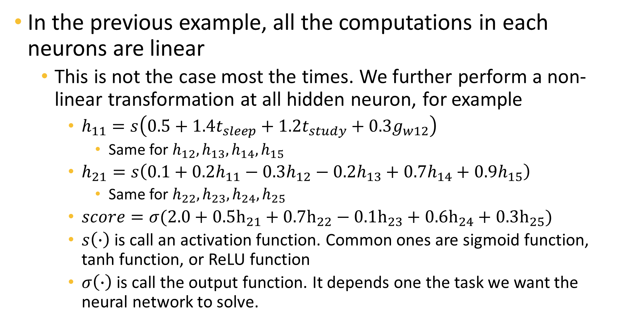
Note
In the previous example, all the computations in each neurons are linear
This is not the case most the times. We further perform a non-linear transformation at all hidden neuron, for example
$h_{11}=s\left(0.5+1.4t_{sleep}+1.2t_{study}+0.3g_{w12}\right)$
Same for $h_{12},h_{13},h_{14},h_{15}$
$h_{21}=s\left(0.1+0.2h_{11}−0.3h_{12}−0.2h_{13}+0.7h_{14}+0.9h_{15}\right)$
Same for $h_{22},h_{23},h_{24},h_{25}$
$score=σ(2.0+0.5h_{21}+0.7h_{22}−0.1h_{23}+0.6h_{24}+0.3h_{25})$
$s\left(∙\right)$ is call an activation function. Common ones are sigmoid function, tanh function, or ReLU function
$σ\left(∙\right)$ is call the output function. It depends one the task we want the neural network to solve.

Slide 10










How Neural Network Learns
The process to obtain the output from a set of input we described previously is call a “feedforward” phase
The result is a predicted value of score for the input student which would not perfectly equal to their true score
The difference between the true score and the predicted score is then used to update the weights in all the equations (the $±0.x$ numbers in my previous examples). This phase is called backpropagation
One pass of feedforward and backpropagation makes up one training epoch. The neural network repeat the two steps until the difference between true values and predicted values is acceptable
$$score_{predicted}=99$$
$$score_{true}=95→difference=4$$
$$score_{true}=95$$
Feedforward
Backpropagation
$$t_{sleep}=5$$
$$t_{study}=6$$
$$g_{w12}=98$$
$$t_{sleep}=5$$
$$t_{study}=6$$
$$g_{w12}=98$$
(the input and output of the first student)
(the input and output of the first student)

Slide 11
Why Neural Networks are Good
The stacked-neuron structures allow neural networks to model very complicated relationships between input and outputs
Equivalently, neural networks can model very high-level non-linearity in data
Furthermore, the feedforward-backpropagation training process of neural networks allow them to learn features and correlations among data by themselves
Neural networks that are trained in one dataset can be adapt to solve problems in a similar dataset without the needs of retraining them from the beginning

Slide 12
In SKLearn
As you can see, NN models have two important hyper-parameters
Number of hidden layers
Number of neurons in each layers
This makes NNs a bit trickier to train – there are two many possibilities for these hyperparameters
Some of my personal experiences with DNN:
Deeper models are more difficult to overfit, but also are more difficult to train
Wider models (i.e., more neurons per layers) are easier to train but also easier to overfit the data
In general, we usually train networks with three to five hidden layers
The numbers of neurons in each layer are not necessarily equal, however I usually use equal numbers, and equal to a factor of number of input features
For example, if we have 5 input features, then each layer may have 5, 10, 15, or 20 neurons
In sklearn, NNs are quite a bit slower to train than other models. So, you should limit the number of architectures to try, especially when the data is large
In sklearn, we use MLPClassifier for classification, and MLPRegressor for regression

